Slide 1
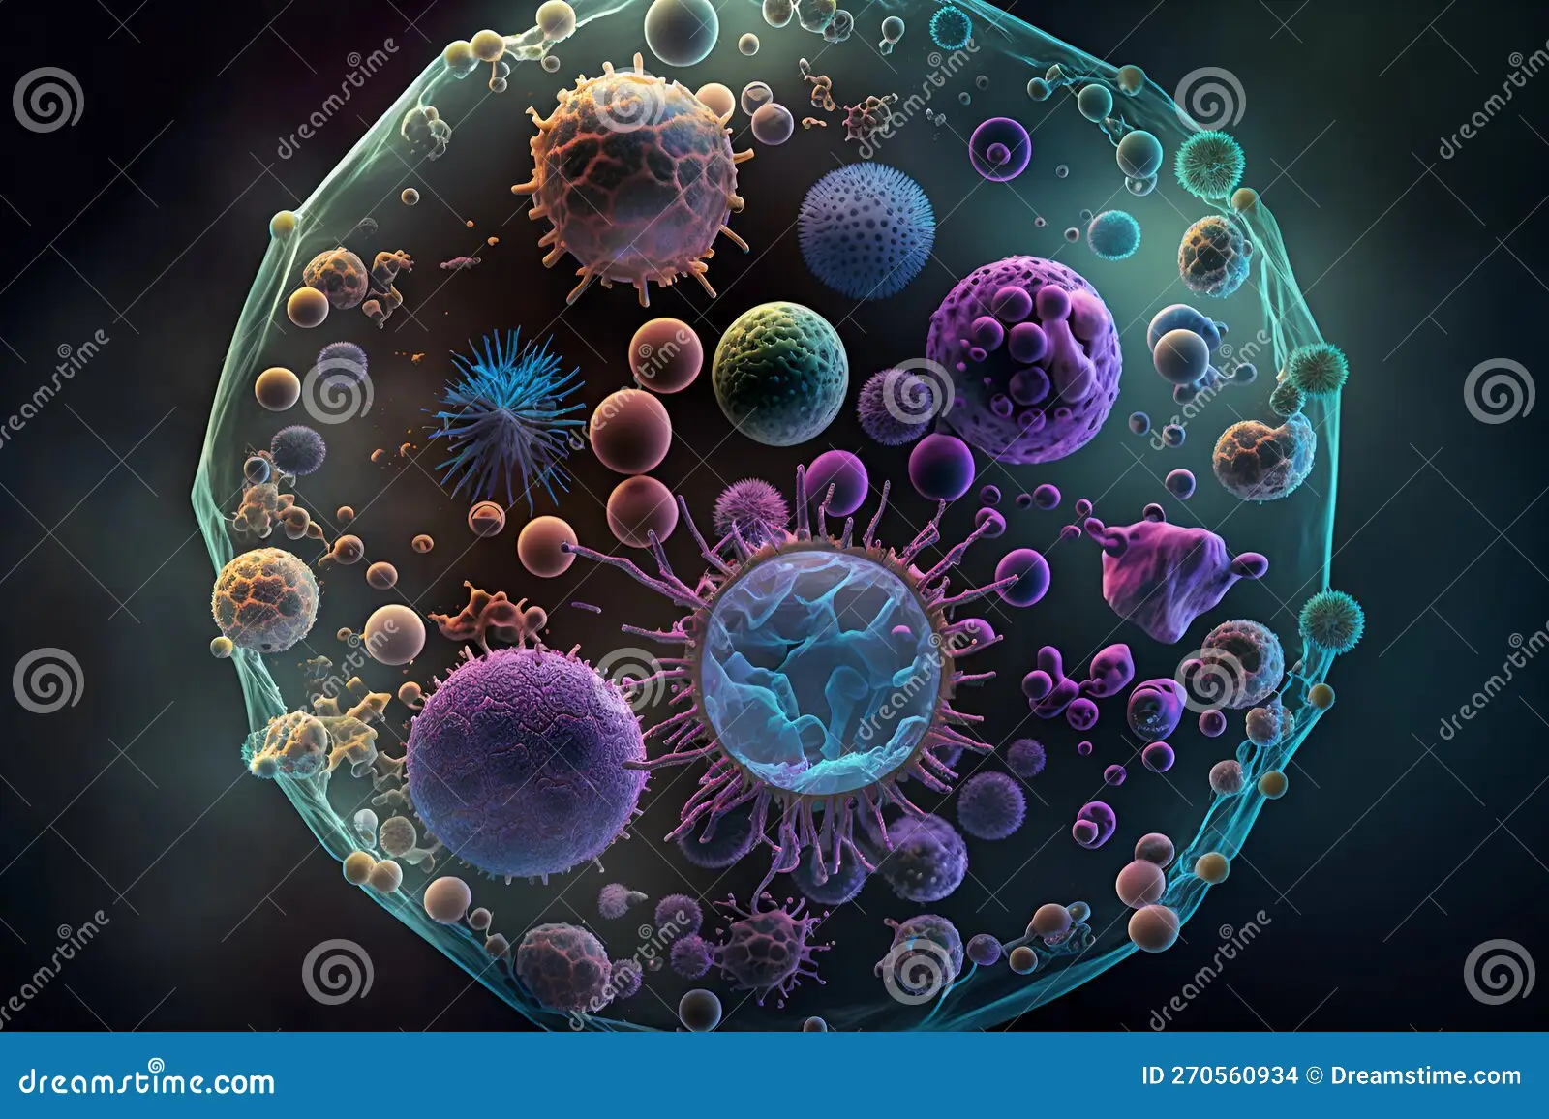
THE MICROBIAL WORLD

Slide 2
Microbiology: is the study of Microorganisms (or microbes) , microscopic or so small that they cannot be seen with the naked eye Microorganisms : Any living organism that is either a single cell (unicellular), a cell cluster, or has no cells at all (acellular). Sub groups of Microbes we will study: -Bacteria -Fungi (yeasts and molds) -Algae -Protozoa -Multicellular parasites -Viruses

Slide 3
Microbiology
The field is concerned with the structure, function, and classification of such organisms and with ways of both exploiting and controlling their activities.
This field study includes basic microbial research, research on infectious diseases, study of prevention and treatment of disease, environmental functions of microorganisms, and industrial use of microorganisms for commercial, agricultural, and medical purposes.

Slide 4
Microbes are Essential for Life on Earth
Microbes have many important and beneficial biological functions:
Photosynthesis
Algae and some bacteria capture energy from sunlight and convert it to food, forming the basis of the food chain.
Decomposition
Many microbes break down dead and decaying matter and recycle nutrients that can be used by other organisms.
Nitrogen Fixation
Some bacteria can take nitrogen from air and incorporate it into soil.

Slide 5
Microbes are Essential for Life on Earth
Digestion
Animals have microorganisms in their digestive tract, that are essential for digestion and vitamin synthesis.
- Cellulose digestion by ruminants (cows, rabbits, etc.)
- Vitamin K and B synthesis in humans.
Medicine
Many antibiotics and other drugs are naturally synthesized by microbes.
- Penicillin is made by a mold.

Slide 6
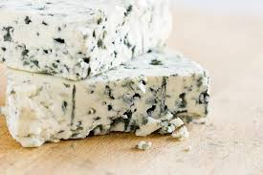
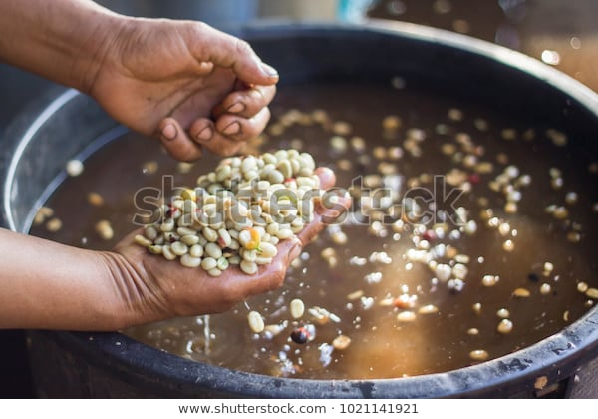
Microbes are Essential for Life on Earth
Food Industry
Many important foods and beverages are made with microbes:
Alcoholic beverages (Wine, beer, rum, whiskey)
Bread
Vinegar
Soy sauce
Cheese
Pickles, olives
Yogurt
Buttermilk
Sour cream
Fermented coffee
Chocolate
Fermented hams, sausages

Slide 7
Microbes are Essential for Life on Earth
Genetic Engineering
Recent advances in gene splicing allow us to design recombinant microbes that produce important products:
Human growth hormone (Dwarfism)
Insulin (Diabetes)
Blood clotting factor (Hemophilia)
Human hemoglobin (Emergency blood substitute)
Erythropoietin (Anemia)
Monoclonal antibodies (Disease diagnosis and prevention).

Slide 8
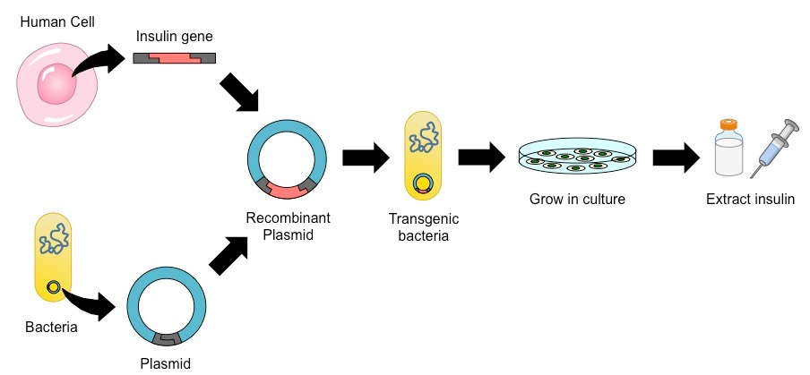

Slide 9
Microbes are Essential for Life on Earth
Medical Research
Microbes are well suited for biological and medical research for several reasons:
Relatively simple and small structures, easy to study.
Genetic material is easily manipulated.
Can grow a large number of cells very quickly and at low cost.
Short generation times make them very useful to study genetic changes.

Slide 10
History of Microbiology
Early Studies
Before 17th century, study of microbiology was hampered by the lack of appropriate tools to observe microbes.
Anton van Leeuwenhoeck : In 1673 was the first person to observe live microorganisms which he called “ animalcules” (bacteria, protozoa), using single-lens microscopes that he designed.

Slide 11
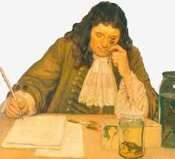
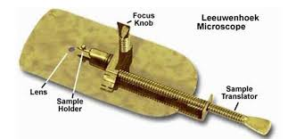
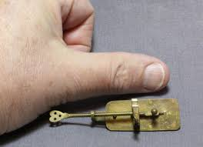

Slide 12
History of Microbiology
Spontaneous Generation vs Biogenesis
Before 1860s many scientists believed in Spontaneous generation, i.e.: That living organisms could arise spontaneously from nonliving matter:
Mice come from rags in a basket.
Maggots come from rotting meat.
Ants come from honey.
Microbes come from spoiled broth.

Slide 13
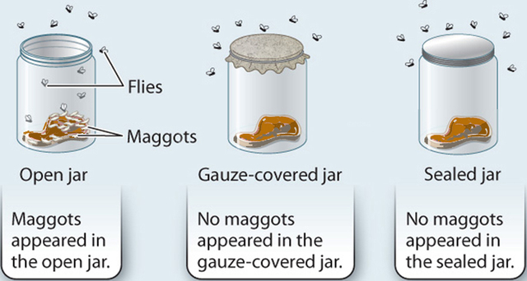
History of Microbiology
Spontaneous Generation vs Biogenesis
Theory of Biogenesis:
Belief that living cells can only arise from other living cells or decomposing matter .
Francesco Redi :In 1668 proved
that maggots do not arise
spontaneously from decaying meat
but came from fly eggs.

Slide 14
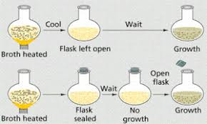
But Could Spontaneous Generation Be True for Microorganisms?
u Lazzaro Spallanzani: In 1765 found that nutrient broth that had been heated in a sealed flask would not become contaminated with microbes.
Some proponents of spontaneous generation argued that boiling had destroyed the “life force” of air in flask.
Others argued that microbes were different from other life forms.

Slide 15
History of Microbiology
Spontaneous Generation vs Biogenesis
Debate was finally settled by Pasteur.
Louis Pasteur: In 1861 finally disproved spontaneous generation when he demonstrated that microorganisms in the environment were responsible for microbial growth in nutrient broth.
Designed swan neck flasks that allowed air in, but trapped microbes in neck.
Developed aseptic technique: Practices that prevent contamination by unwanted microorganisms.

Slide 16
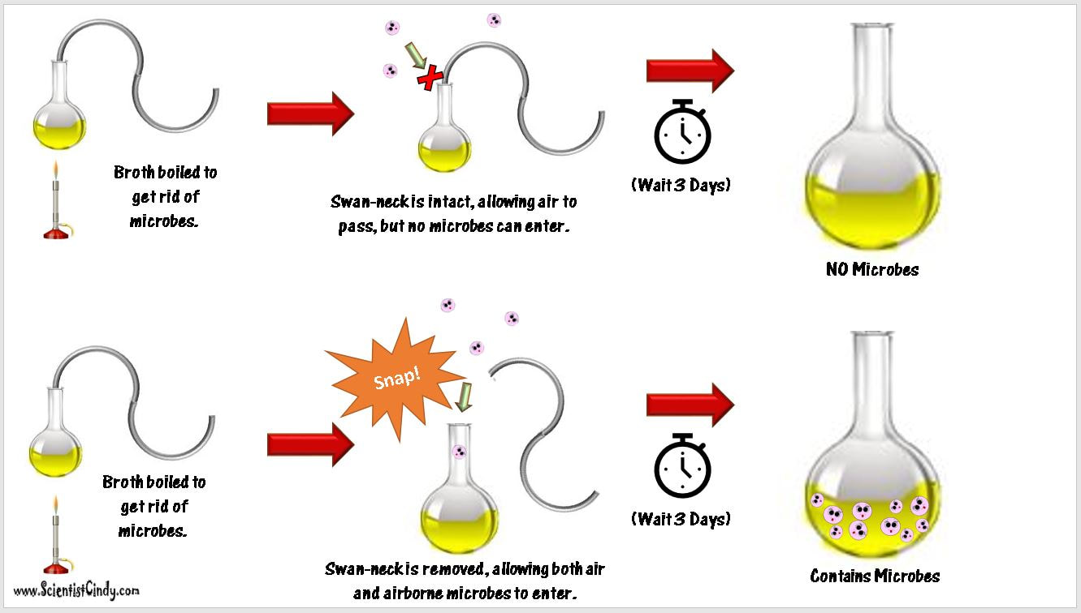
Swan-neck flask’ experiments

Slide 17
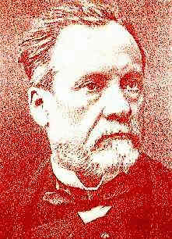
History of Microbiology
Golden Age: 1857-1914
Pasteur’s Contributions to Microbiology:
Fermentation: Pasteur found that yeasts were responsible for converting sugar into alcohol in the absence of air.
Souring and spoilage were caused by bacterial contamination of beverages.
Pasteurization: Developed a process in which liquids are heated (at 65°C) to kill most bacteria responsible for spoilage.

Slide 18
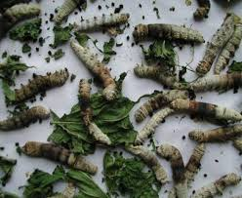
History of Microbiology
Golden Age: 1857-1914
Pasteur’s Contributions:
Disease Causes: Identified three different microbes
that caused silkworm diseases.
Vaccine: Developed a vaccine for rabies from dried spinal cords of
infected rabbits.
Directed Pasteur Institute until his death in 1895.

Slide 19
History of Microbiology
Golden Age: 1857-1914
Germ Theory of Disease: Belief that microbes cause diseases. Before, most people believed diseases were caused by divine punishment, poisonous vapors, curses, witchcraft, etc.
Agostino Bassi (1835): Found that a fungus was responsible for a silkworm disease.
Ignaz Semmelweis (1840s): Demonstrated that childbirth fever was transmitted from one patient to another, by physicians who didn’t disinfect their hands. He was ostracized by colleagues.

Slide 20
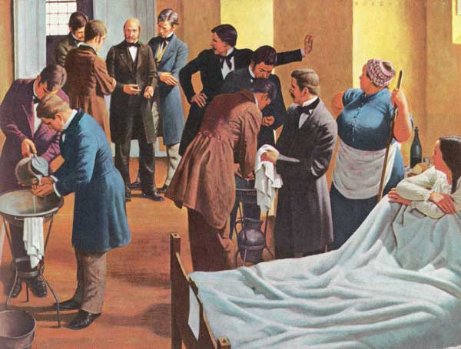

Slide 21
History of Microbiology
Golden Age: 1857-1914
Germ Theory of Disease:
Joseph Lister (1860): Used disinfectant to treat surgical wounds, greatly reducing infection rates. Considered the father of antiseptic surgery.

Slide 22
History of Microbiology
Golden Age: 1857-1914
Robert Koch (1876): First person to conclusively prove that a specific bacterium caused a disease.
Germ Theory: One microbe causes one specific disease.
Proved that Bacillus anthracis causes anthrax in cattle.
Later identified bacterium that causes tuberculosis.
used criteria developed by his teacher Jacob Henle (1809-1895)
these criteria now known as Koch’s postulates
still used today to establish the link between a particular microorganism and a particular disease

Slide 23
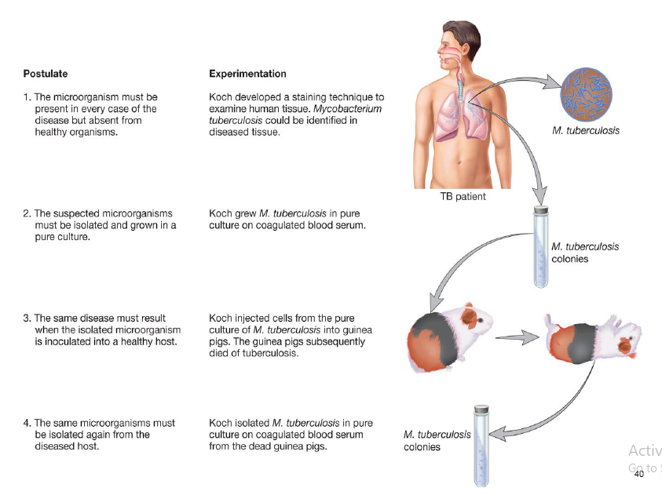
Koch’s postulates

Slide 24
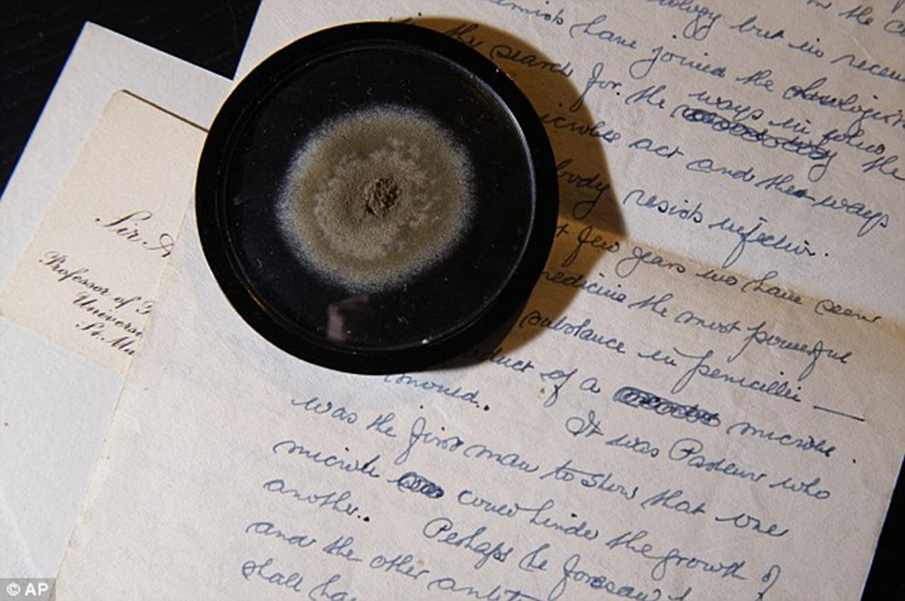
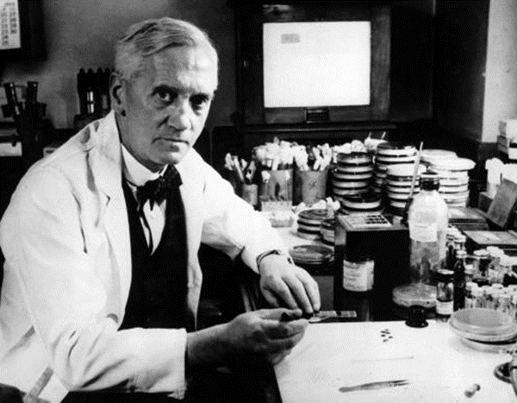
History of Microbiology
Modern Microbiology: After 1914
Alexander Fleming (1928): Discovered that penicillin produced by the mold Penicillium notatum was able to prevent microbial growth.
Penicillin was not mass produced until the 1940s.

Slide 25
History of Microbiology
Modern Microbiology: After 1914
Problems with Chemotherapy:
Toxicity
Drug resistant microbes

Slide 26
History of Microbiology
Modern Microbiology: After 1914
But on the other side development in molecular and genomic methods led to a second golden age of microbiology (rapid expansion of knowledge)
Discoveries
–restriction endonucleases (Arber and Smith)
–first novel recombinant molecule (Jackson, Symons, Berg)
–DNA sequencing methods (Woese, Sanger)
–bioinformatics and genomic sequencing and analysis

Slide 27
Major Fields in Microbiology
Medical microbiology –
diseases of humans and animals
Public health microbiology
control and spread of communicable diseases
Immunology
how the immune system protects a host from pathogens

Slide 28
Major Fields in Microbiology
Microbial ecology
concerned with the relationship of organisms with their environment
Agricultural microbiology
concerned with the impact of microorganisms on agriculture
–food safety microbiology
–animal and plant pathogens

Slide 29
Industrial microbiology
began in the 1800s
–fermentation
–antibiotic production
–production of cheese, bread, etc.
Microbial physiology
studies metabolic pathways of microorganisms

